Slide 1
10/24/18
MGT 217: Teams

Slide 2
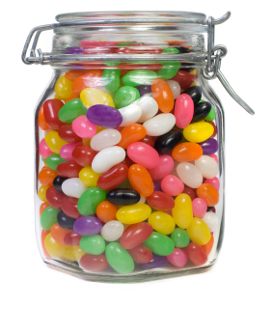
Jelly Beans & The Power of the Group

Slide 3
Video
https://www.youtube.com/watch?v=uz5AeHqUtRs

Slide 4
What is a Team?

Slide 5
Teams and Teamwork in Contemporary Organizations
A team is a collection of people brought together to apply their individual skills to a common project or goal.
Notes:
There is no doubt that teams and teamwork play a critical role in the success of 21st century organizations. The most successful organizations value and understand the nature of teams and create a productive environment where teams flourish. A team is a collection of people brought together to apply their individual skills to a common project or goal. Regardless of the type of organization, most employees work in some form of a team in today’s workplace. Compared to a few decades ago, teamwork has become quite commonplace in contemporary organizations. But what has caused this dramatic shift to team structures?

Slide 6
Teams versus Groups
Teams and Teamwork in Contemporary Organizations
Groups consist of three or more people who work independently to attain organizational goals.
Teams consist of a number of people, who use their complementary skills to collaborate in a joint effort.
Notes:
The terms “teams” and “groups” are often used interchangeably, but there are subtle differences between them. A group usually consists of three or more people who work independently to attain organizational goals. For example, in a small business, there might be three people in the marketing department; one might be focused on sales, another on branding; and a third on the administration associated with those tasks. In contrast, teams consist of a number of people, usually between 3 and 7, who use their complementary skills to collaborate in a joint effort. Teams with fewer than 3 people tend not to derive the benefits of a collaborative team, and teams with more than 7 tend to have communication and control issues. In this chapter we focus on teams.

Slide 7
Teams
What are the advantages of a team?
What are the disadvantages of a team?

Slide 8
“Lost at Sea” Exercise

Slide 9
“Lost at Sea” Exercise
You are adrift on a private yacht in the South Pacific. A fire of unknown origin has destroyed much of the yacht and its contents, and it is slowly sinking. Your location is unclear because of the destruction of critical navigational equipment and because you and the crew were distracted trying to bring the fire under control. Your best estimate is that you are approximately 1,000 miles south-southwest of the nearest land.

Slide 10
“Lost at Sea” Exercise
Below, there is a list of 5 items that are intact and undamaged in the fire. In addition to these articles, you have a serviceable, rubber life raft with oars – large enough to carry you, the crew, and the items listed. The total contents of all survivors’ pockets are a pack of cigarettes, several books of matches, and several one-dollar bills.
Rank these items as most important to least important (1-5)
Water
Maps of the Pacific Ocean
Opaque Plastic
Shaving Mirror
Rum

Slide 11
“Lost at Sea” Exercise
Rank the items as an individual first
Form your teams
Rank items as a group (come to consensus)

Slide 12
“Lost at Sea” Exercise
Solution
Who did better as individual?
Who did better as a team?

Slide 13
Are Teams Effective?
Teams and Teamwork in Contemporary Organizations
The effectiveness of work teams depends on how well they are managed and treated within the organization.
What is the ideal team size?
Notes:
The effectiveness of work teams depends on how well they are managed and treated within the organization. A well-run team is usually productive, innovative, loyal, and adaptable. Organizations that consistently nurture teams tend to experience reduced turnover and absenteeism. However, teams can certainly fail if they are mismanaged, and if they are not implemented properly, they can actually cause more harm than good.

Slide 14
Team Size
Team members tend to happiest with teams of 4 to 7.

Slide 15
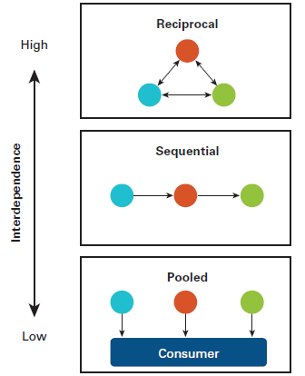
A Model of Team Effectiveness: Context and Composition
Figure 7.2: Levels of Task Interdependence
Notes:
There are three levels of interdependence. Pooled Interdependence occurs when each team member produces a piece of work independently of the others. Sandwich fast-food restaurant Subway is an example of pooled interdependence. While each restaurant unit is a part of the overall Subway organization, the units work independently of each other. Sequential Interdependence takes place when one team member completes a piece of work and passes it on to the next member for his or her input, as on an assembly line. Car manufacturer Toyota’s production system is partly based on sequential interdependence. Reciprocal Interdependence happens when team members work closely together on a piece of work, consulting with each other, providing each other with advice, and exchanging information. For example, the teams at Parkland Memorial Hospital rely on reciprocal interdependence to manage the intense coordination of the different services provided to patients and the movement between those services.

Slide 16
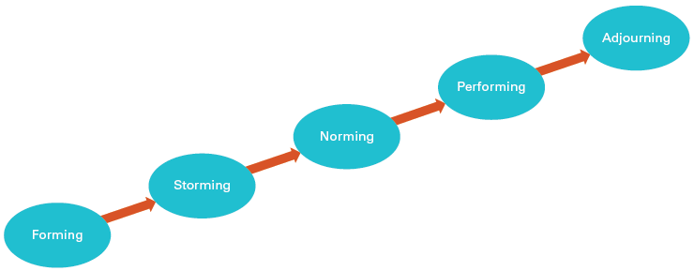
A Model of Team Effectiveness: Processes and Outcomes
Figure 7.4: The Tuckman Model of Team Development
SOURCE: Tuckman, Bruce. “Developmental Sequence in Small Groups.” Psychological Bulletin 63 (1965): 384−399.
Notes:
When teams first come together they go through a number of stages in the process of becoming a team. In his original model of group development in 1965, psychologist Bruce Tuckman named the stages “forming, storming, norming, and performing” (Fig. 7.2). Forming – In the first stage of group development the members meet for the first time, get to know each other, and try to understand where they fit within the team structure. During this period, team members will be polite to each other and tend to avoid conflict. Storming – After a period of time, tensions may arise between members and different personalities might clash, leading to conflict within the team. Norming - The team members resolve the conflict and begin to work well together and become more cohesive. Performing – The team becomes invested in achieving its goals and operates as a unit. At this stage, there is high loyalty and trust between members. Adjourning – when individuals either leave the team or have no reason to be in further contact with their team mates – successfully completing a group project, for example. Twelve years later, Tuckman created a fifth stage called “adjourning”.

Slide 17
Synergy: Process Gains and Losses
A Model of Team Effectiveness: Processes and Outcomes
Synergy is the interaction that makes the total amount of work produced by a team greater than the amount of work produced by individual members working independently.
Notes:
Synergy refers to the interaction that makes the total amount of work produced by a team greater than the amount of work produced by individual members working independently.

Slide 18
Team Issues
Process gain - getting more from the team than you would from its members.
  Synonymous with synergy.
  Results in resources that didn’t exist before the team created them.
Process loss - getting less from the team than you would from its members.
Social loafing- people exert less effort in teams than when working alone

Slide 19
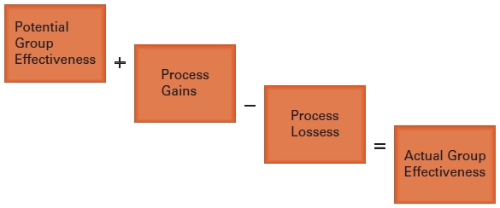
Synergy: Process Gains and Losses
A Model of Team Effectiveness: Processes and Outcomes
Figure 7.5: A Model of Process Gains and Losses
Notes:
Process gains, which are the degree to which certain factors contribute to team effectiveness. Process gains include: a sense of shared purpose, plans, and goals; the confidence team members have in their own abilities to achieve objectives; a shared vision of the way the work should be carried out; and constructive task-focused conflict, which can help teams with their problem-solving and decision-making. Brian concludes that the purchasing team members have the skills to complete their tasks but do not share a vision of how these tasks should be performed. Process losses, the factors that detract from team effectiveness. Process losses include: social loafing, which is the reduced effort people exert in a group compared to the amount they supply when working independently; personality clashes or unproductive conflict; and the inability to focus on certain tasks.

Slide 20
Groupthink
What is it?

Slide 21
Team Decision Making
Groupthink is a psychological phenomenon in which people in a cohesive group go along with the group consensus rather than offering their own opinions.
Notes:
Groupthink is a psychological phenomenon in which people in a cohesive group go along with the group consensus rather than offering their own opinions. Groupthink is a major disadvantage to team decision-making, because the team members are more concerned with preserving harmony in the group than with risking opinions that may cause conflict or offense. Being in this kind of group confers an illusion of immunity, an “us against the world” view that the group members know better than outsiders even given evidence to the contrary.

Slide 22
How can we collect ideas from everyone in the team?

Slide 23
Team Decision Approaches
Team Decision Making
Brainstorming is generating creative, spontaneous ideas from all members of a group without making any initial criticism or judgment of them.
Notes:
Brainstorming is generating creative, spontaneous ideas from all members of a group without making any initial criticism or judgment of them. “I think that’s a great idea!” he says. “What do you think?” he addresses the rest of the group, who nod in response. “We’d like to hear all your ideas. The more imaginative and creative, the better. We’re looking for original solutions here.”

Slide 24
Team Decision Approaches
Team Decision Making
The Nominal Group Technique is a structured way for team members to generate ideas and identify solutions.
Notes:
The Nominal Group Technique is a structured way for team members to generate ideas and identify solutions. Each member is asked the same question in relation to a work issue and requested to write as many answers as possible. Answers are read aloud and recorded for discussion. Then the ideas are put to the vote. No criticism or judgment of any ideas is allowed.

